Slide 1
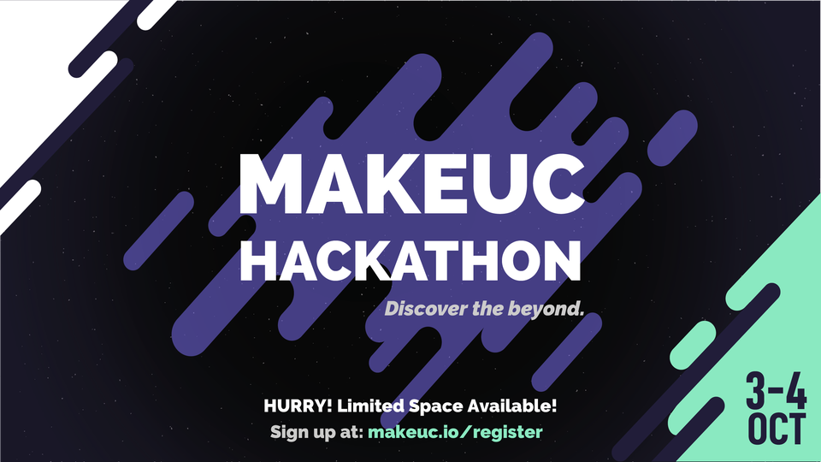


Organised on: Presented by:
Submission by : TEAM TECH_CURIE
Theme : MENTAL HEALTH | ML-ANDROID

Slide 2
TEAM: TECH_CURIE
Hey, I'm VANSHIKA NAMDEV from Saharanpur, Uttar Pradesh. Currently I'm a Btech student in KIET GROUP OF INSTITUTIONS. I'm a self motivated and determined person. “SELP” is a very important project for me and I had a lot of fun with my team in making this project.
Hi, I'm AMISHA SHARMA from ghaziabad, uttar Pradesh. Currently I'm pursuing my b.tech from KIET GROUP OF INSTITUTION. I will always try to enhance my knowledge in different domains and try something new. I am working with my team with full of joy and enthusiasm.
Hello everyone I’m AYUSHI TYAGI currently pursuing my b.Tech from KIET GROUP OF INSTITUTIONS in computer science. I am a person which believes in self learning and self exploration. I am working with my team in this project with full enthusiasm.
VANSHIKA
NAMDEV
AMISHA SHARMA
AYUSHI
TYAGI

Slide 3

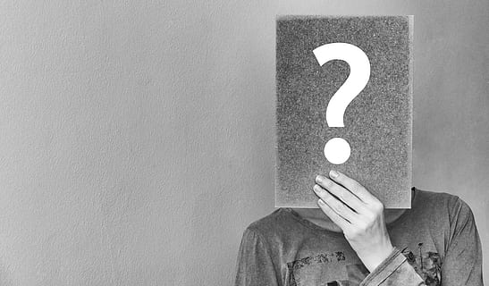
PROBLEM STATEMENT
- Globally, more than 264 million people of all ages suffer from depression/ mental trauma.
- Depression is a leading cause of disability worldwide and is a major contributor to the overall global burden of disease.
- More women are affected by depression than men.
- Mental trauma can lead to suicide. There are effective psychological and pharmacological treatment for moderate and severe depression.
- Students are facing mental health issues and the larger problem is the lack of awareness and the clout around the term mental health, we are looking for methods to make students more aware about mental health issues and also clearing the clout around it.
-

Slide 4


PRESENTING TO YOU!!

Slide 5


SOLUTION WE THOUGHT:
We came up with a MOBILE APPLICATION named “SELP”. This android application integrated with Machine Learning will predict the mental health condition of the user.
By predicting the result we recommend users some movies, books, music, meditation sessions, based on their response which helps them to improve their mental health.

Slide 6
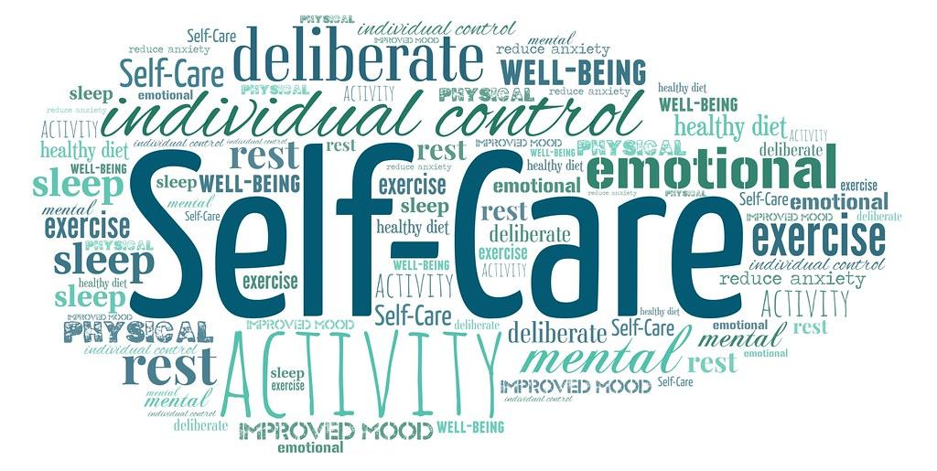

HOW “SELP’’ WORKS ?
- Firstly user can REGISTER themself in an app, after registering account is successfully created in SELP and next time they visit they directly LOGIN with their unique id.
- After login the QUIZ will be started, that questions are based on our daily life experience.
- As per quiz our app will predict result by using machine learning model and conclude the result that if the user is actually suffering from mental trauma.
- And then app will recommend the user some movies, music, books, yoga asanas, and counsellors to improve their mental health .

Slide 7
POSITIVE AND UNIQUE FEATURES
SECURE AND SAFE
‘’SELP’’ don’t access your personal information. No authentication needed, this app only require your email id and password and your account is created in sahayak and you easily access it.
EFFICIENT AND RELIABLE
Peoples usually hesitate to give their personal information, ‘’SELP” don’t access your privacy you just simply login by create your username and password and you easily access it in a one simple step.
1
2
3
SUPPORTS MULTI LANGUAGE
“SELP” supports multi language too such that those who are not familiar with english language can use it in their own common language too.
BOOK SESSION THROUGH BITCOIN
“SELP” recommends counselor to you based on your responses and also it enables you to book a session with your recommended counselor and payment will be done through bitcoins.
4

Slide 8


HOW “SELP” WORKS?
REGISTER YOURSELF & LOGIN
STEP 1:
STEP 2:
START THE QUIZ
STEP 3:
CHECK THE RESULT
STEP 4:
GO THROUGH THE RECOMMENDATIONS

Slide 9
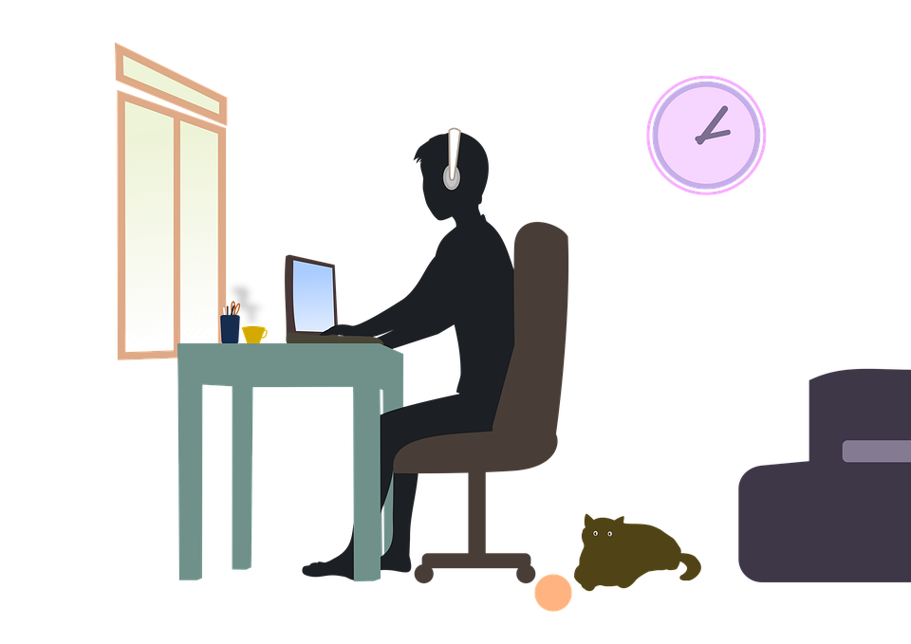
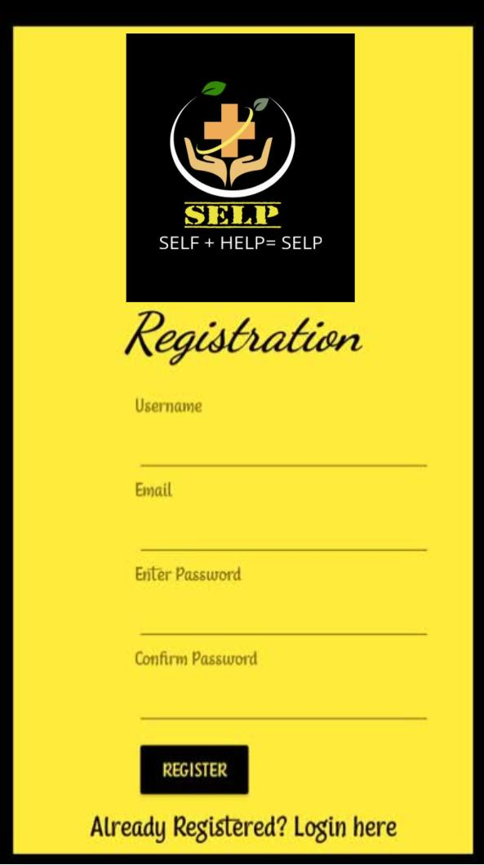
Step 1: REGISTER YOURSELF IN “SELP”!!
- FIRST REGISTER YOURSELF IN SELP BY CREATING YOUR USERNAME, ENTER YOUR EMAIL I’D AND PASSWORD.
- YOUR ACCOUNT IS SUCCESSFULLY CREATED!! AFTER THAT YOU CAN DIRECTLY LOGIN IN “SELP”.

Slide 10


Step 2: START THE QUIZ!!
- START YOUR QUIZ BY SIMPLY CLICKING ON “START” BUTTON
- IF YOU WANT TO KNOW HOW IT WORKS? THEN SIMPLY CLICK ON “ABOUT” ICON AND YOU GET THE INFORMATION.

Slide 11
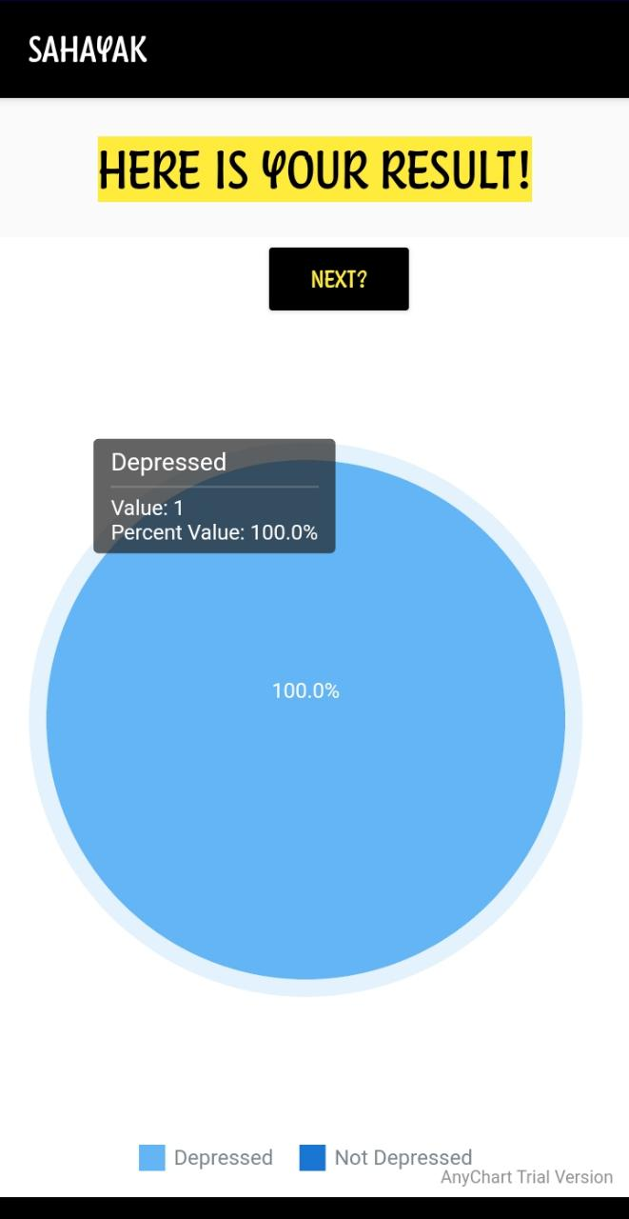



STEP 3: SEE THE RESULT!!
STEP 4: SEE RECOMMENDATIONS
MUSIC BOOKS MOVIES
AFTER ATTEMPTING THE QUIZ CHECK YOUR RESULT i.e WHETHER YOU ARE DEPRESSED OR NOT. IF OUR APP PREDICT THAT YOU ARE DEPRESSED THEN MOVE TO STEP 4
CHECK THE RECOMMENDATIONS PROVIDED BY APP. IT WILL HELP YOU TO RECOVER FROM MENTAL TRAUMA

Slide 12

FUTURE SCOPE
SPEECH RECOGNITION
03
PREDICTION OF OTHER MENTAL DISORDERS
01
02
ONLINE THERAPY

Slide 13
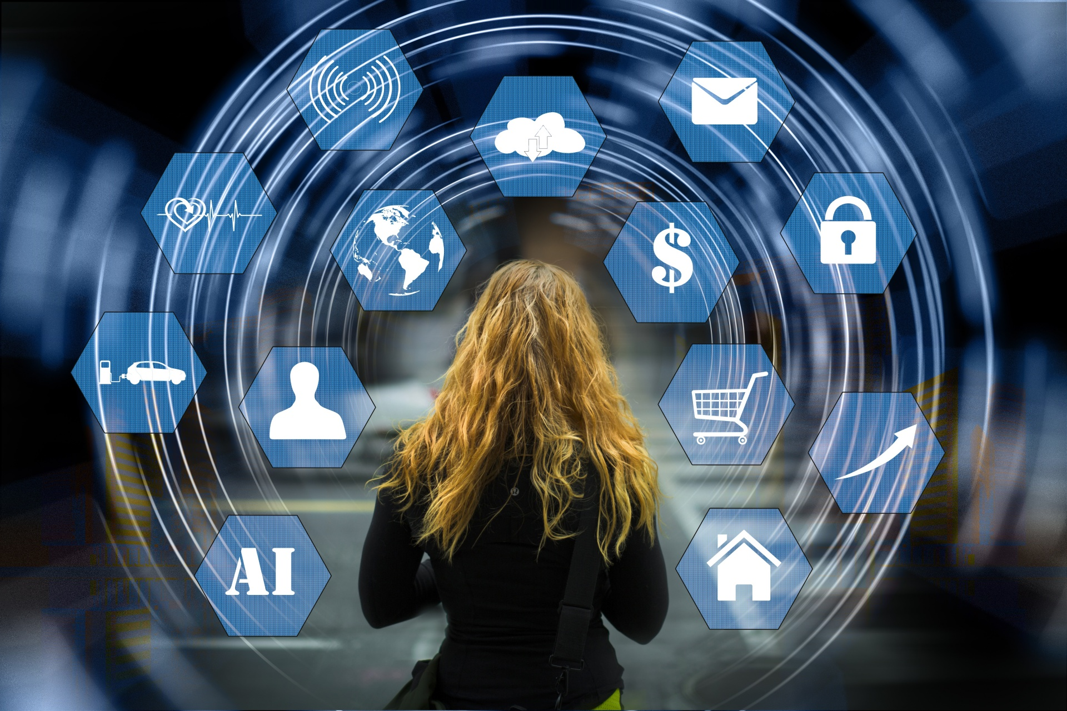
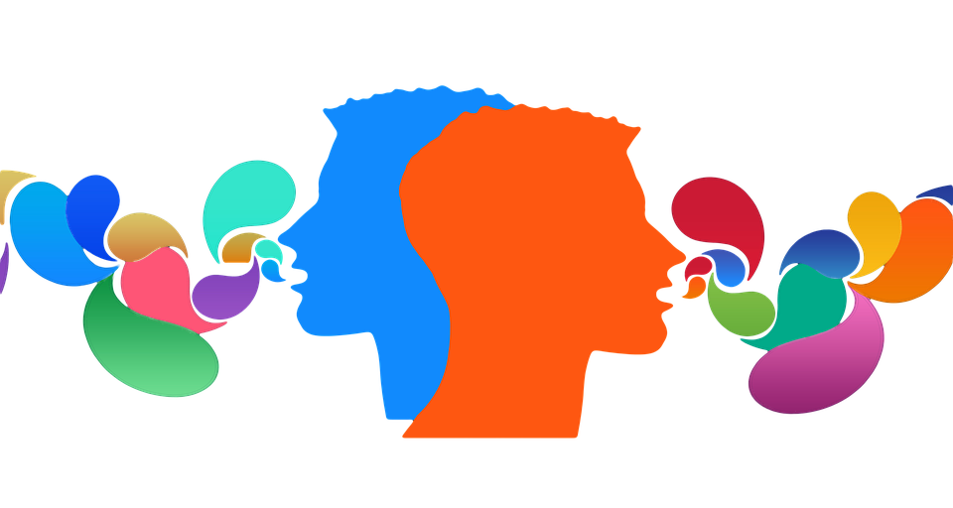
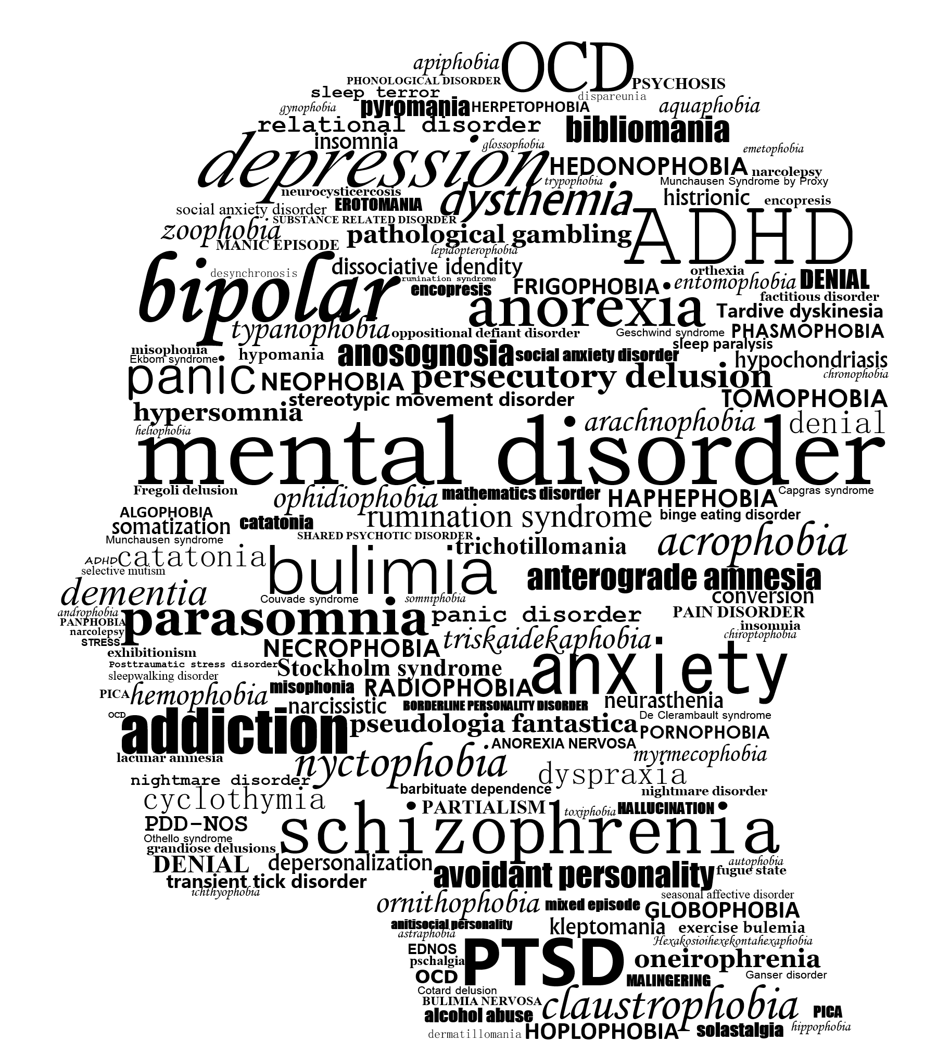


FUTURE SCOPE OF “SELP”
SPEECH RECOGNITION
ANOTHER MENTAL DISORDER
ONLINE THERAPY
1. Currently our app “SELP” detects that a person is suffering from mental trauma/ depression but in future we can add various mental disorders such as anxiety disorder, bipolar disorder, mood disorder, personality disorder and post traumatic stress disorder you can check yourself by attempting the quiz and we will provide solution of your problem.
1. In future we can add online counselling with famous mental health consultants so that the person who want to try therapy can directly take session on the app. We have already provided you online payment through bitcoins, so users can perform safe and secure bitcoin transition. This integration will also enhance the business.
1. We can add speech recognition to the application which will increase ease to use the app.
2. Speech recognition will make this app a worldwide platform and can help everyone.

Slide 14

“WE ARE OPEN FOR ANY QUERIES AND SUGGESTIONS.”

